Slide 1
DSA PROJECT FINAL DEMO
Project officium
Group members:
Fahad shaikh; Mariam Baloch; haris karim ladhani

Slide 2
Introduction
Officium is a personal intelligent assistant, the behavior of which is changed by the user.
We wished to accomplish a stand alone personal assistant along the lines of Cortana and Siri.
Specifically targeting users characterized by technical ineptitude i.e. less tech savvy, Officium helps users perform simple yet important web based computing functions such as:
Navigating to a web page
Sending an email
Google Search
YouTube search for entertainment purposes
Finding information on a particular subject
Weather and Time updates

Slide 3
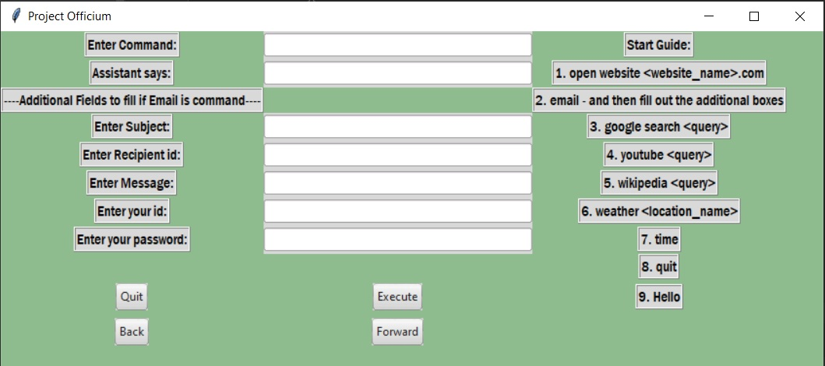
Introduction (Cont’d)
Officium comprises of a GUI which has the following features:
Allows user to enter commands to the assistant via text.
Officium communicates to the user via both text and speech – both methods respectively used where it is deemed appropriate.
Has a self-explanatory start guide that explains the required format of the input commands.

Slide 4
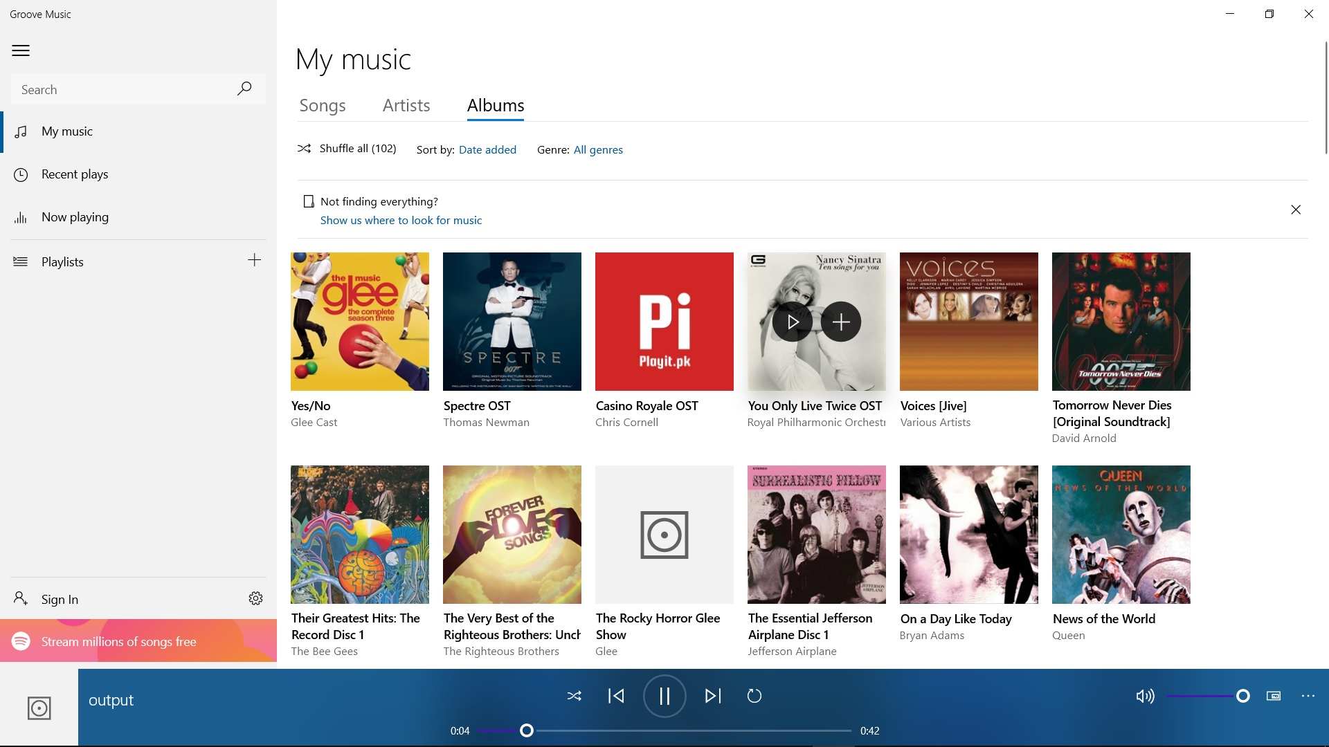
The Speech Function
Officium has 2 different implemented speech functions, they are titled as known in the source code:
Talk – allows for direct audio output via system speakers
Speak – plays converted speech through system default media player, as seen in Fig. 2
The need for these two separate functions lies in the length of the message from Officium to the user. Shorter messages – these are basically notifiers that an command has been executed, they are about 1 to 3 seconds long – are better suited for quick output that does not interrupt the user thus, we use the talk functions for these. Longer messages – about 20 to 40 seconds long are disseminated via the speak function so as to allow the user to terminate them whenever they wish.
Note: For Talk function output example, please see the recorded demo.

Slide 5
The Speech Function (Cont’d)
Concerning the Speak function:
We make use of the gTTS module – a python tool that interfaces with Google Translate’s text to speech API.
It writes spoken mp3 data to a file and plays it via default media player.
Concerning the Talk function:
We make use of the pygame module – it is a cross-platform set of Python modules designed for writing video games. It includes computer graphics and sound libraries designed to be used with the Python programming language.
The mixer method within this module allows for the loading and playing sounds and must be initialized before using it.

Slide 6
The Functions Performed
We shall now move onto the different functions that Officium helps users perform. The first of these is the navigation to a particular webpage, we do this in the following steps:
Performing this operation require the use of the Webbrowser module - The webbrowser module in Python provides an interface to display Web-based documents.
Before we can simply execute the operation, we must first identify the required domain.
The domain is found by using the Regular expression module – This module specifies a set of strings that matches it.
Now what we do is use regular expression functions (re.search()) such that we identify a particular string – in this case we identify the domain of the website to be opened – if the search is successful we pass on a search object to the Webbrowser module – by simply calling the open() function – which then displays the webpage in the user’s web browser.

Slide 7
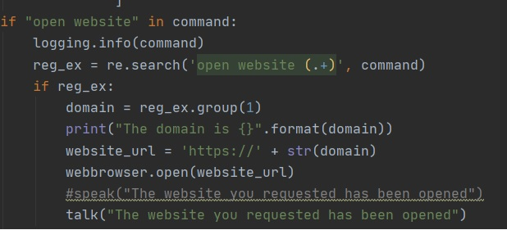
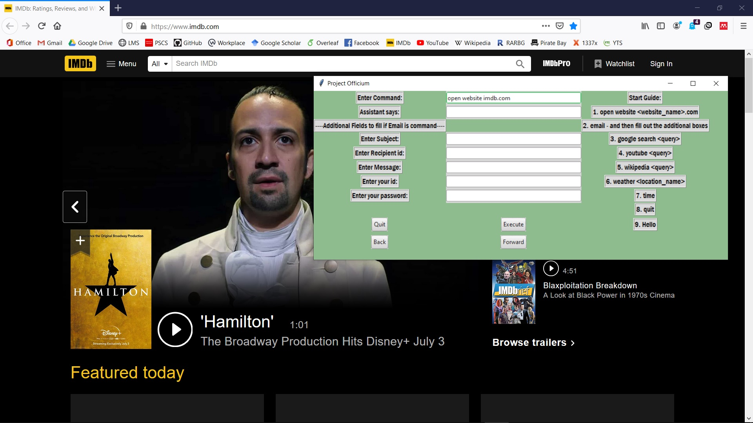
The Functions Performed (Cont’d)
Fig. 4 Output for website navigation to imdb.com

Slide 8
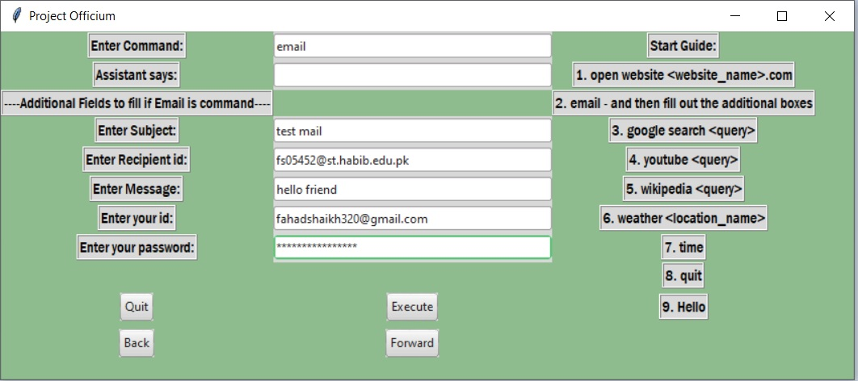
The Functions Performed (Cont’d)
The second function is concerning the sending of emails:
This is possible using the smtplib. SMTP stands for Simple Mail Transfer Protocol.
The smtplib module defines an SMTP client session object that can be used to send mail to any Internet machines with an SMTP (Simple Mail Transfer Protocol) or ESTMP (Extended Simple Mail Transfer Protocol) listener daemon.

Slide 9
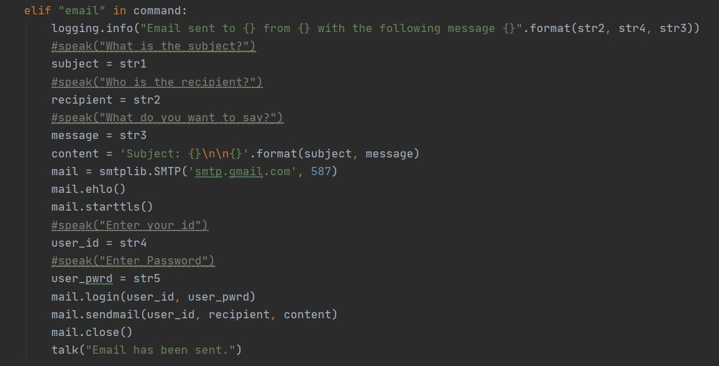
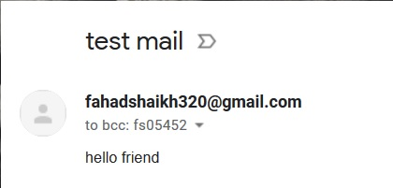
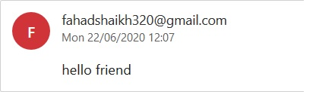
The Functions Performed (Cont’d)
Fig. 7 Output for sending an email – up is sender side and down is receiver side

Slide 10
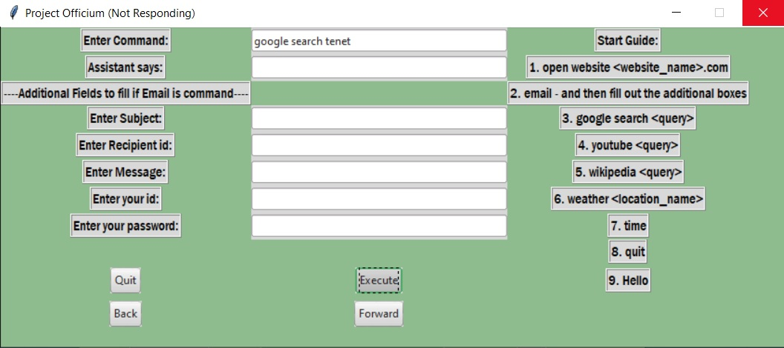
The Functions Performed (Cont’d)
The third function is concerning the google searching:
This is possible using the module called Selenium.
Essentially the Selenium WebDriver is a collection of open source APIs which are used to automate the testing of a web application.
The driver.get method of this module is what navigate us to our webpage – google in this case.
Using the driver.find_element_by_name method we perform the actual search.

Slide 11
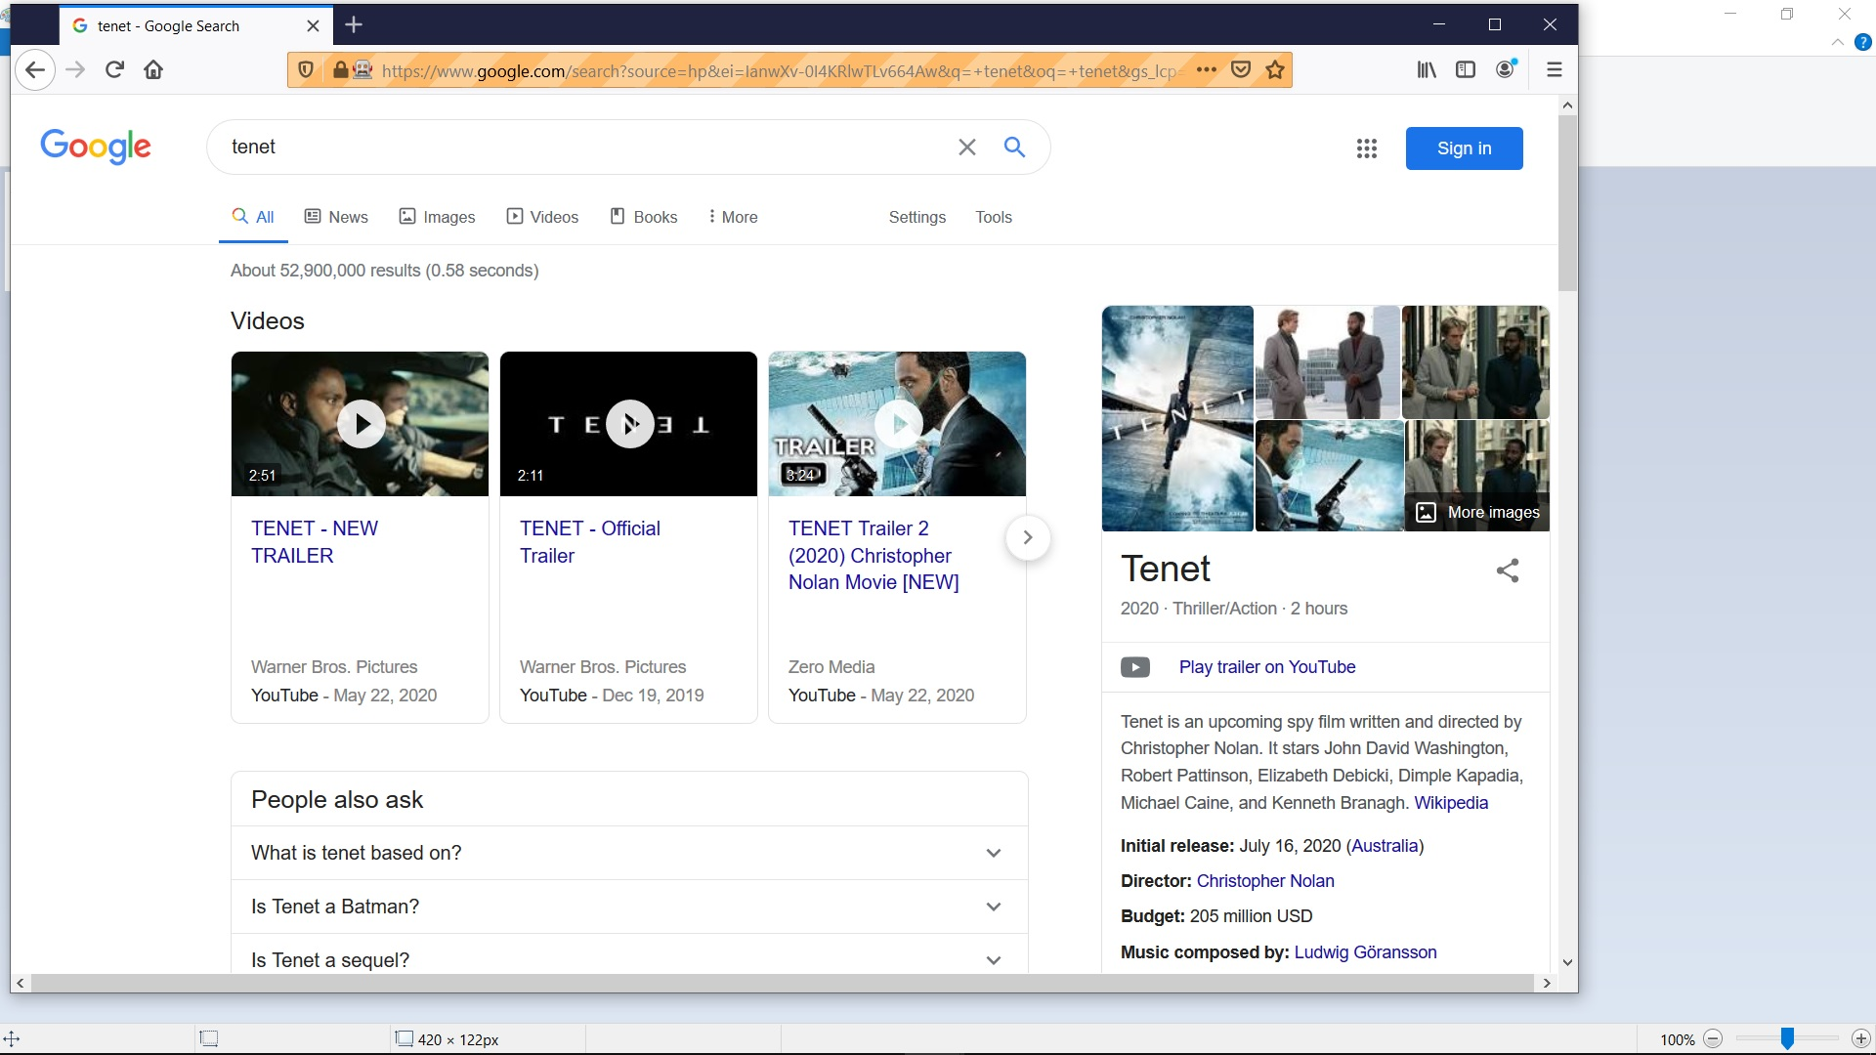
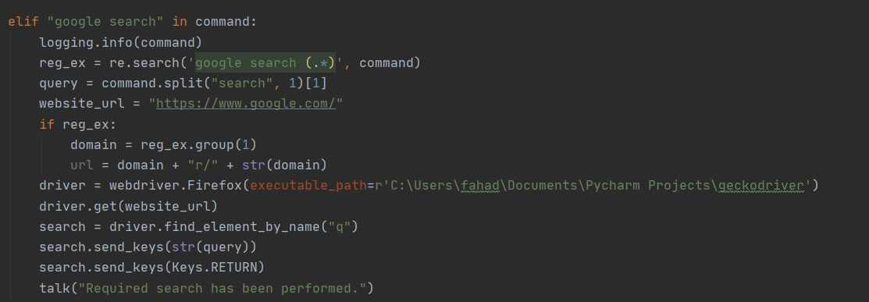
The Functions Performed (Cont’d)
Fig. 10 Output for google search
Note: Performing a google search using Selenium further requires the use of browser specific drivers. For example Firefox uses the Geckodriver.

Slide 12
The Functions Performed (Cont’d)
The fourth function is concerning YouTube search:
This is possibly through the urllib3 module – this is a module that allows us access websites, download data, parse data, modify the headers, and do any GET and POST requests.
Before we can do the actual search, the search key (i.e. search term) must be encoded before it is parsed into the url.
Once the search key has been successfully encoded, the program can successfully access the search results.
We use the function re.findall() to return all non-overlapping matches of patterns in a string as a list of strings. Each video on YouTube has its own 11 characters ID and this findall() expression will find all matches in decoded html content (in search results page).
We use the python strings decode() method to convert the html content from one encoding scheme to one that we require.
Finally, we play the first video in the search results because that result is nearest to our search term.

Slide 13
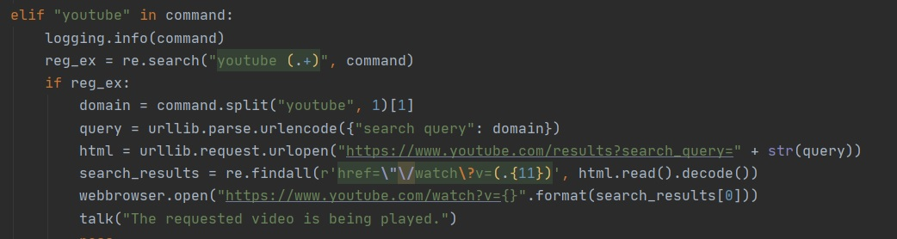
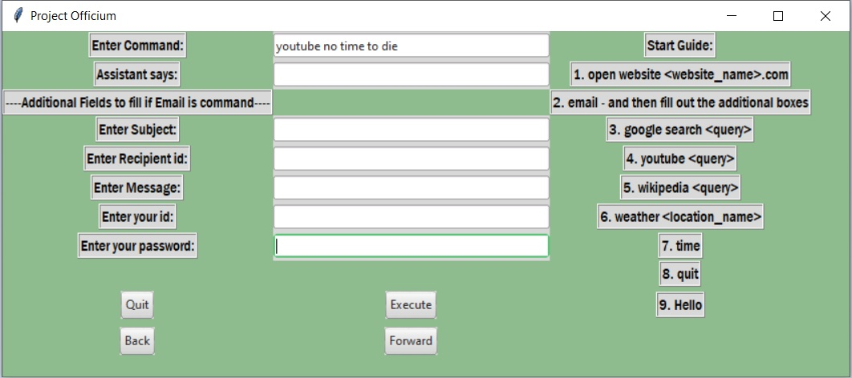
The Functions Performed (Cont’d)
Fig. 12 interface when doing youtube search

Slide 14
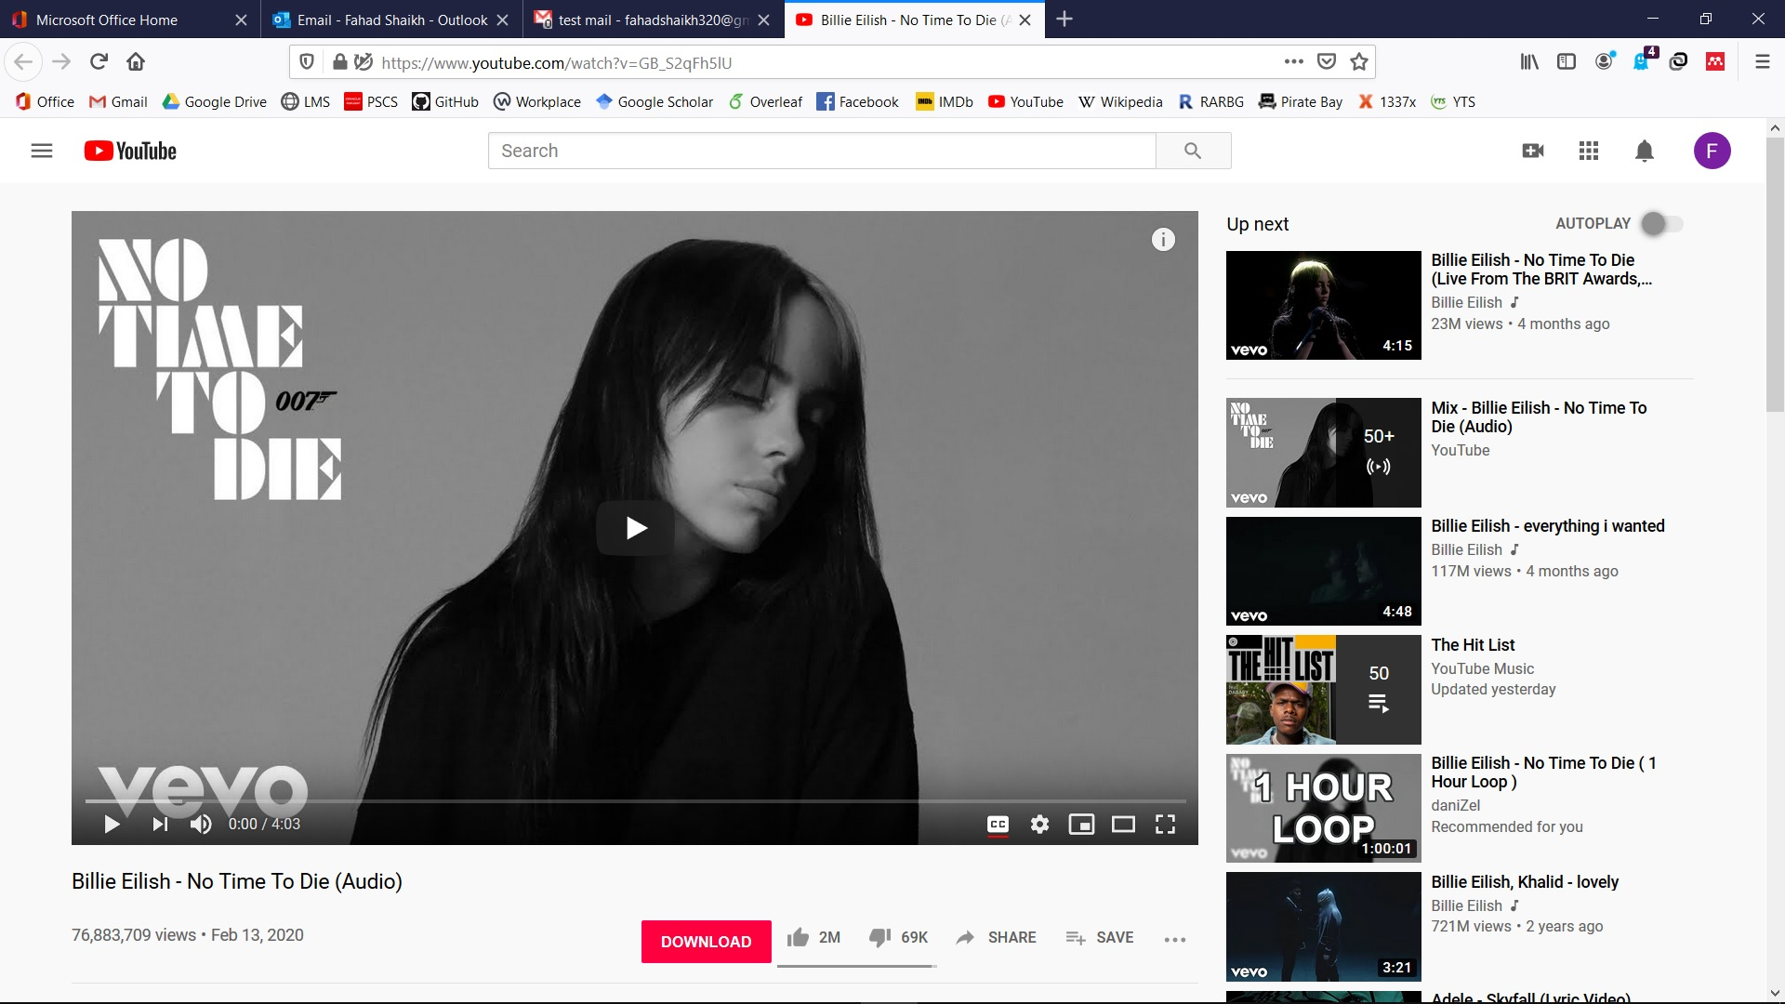

Slide 15
The Functions Performed (Cont’d)
The fifth function is concerning the Wikipedia search:
We first isolate the search term from our entered command by use of regular expression functions.
If the search is successful, we isolate the search term from the match object and then pass it onto the Wikipedia module which results in the following 3 steps:
We send a GET request to Wikipedia with the search query to access data.
Once the request is successful, we parse the Wikipedia content page.
Then we encode the html content into UTF-8 character encoding.
Subsequently we use the join() method to separate the paragraphs of text into lines which we then pass onto the Speak function which then reads the text out like an audio book.

Slide 16
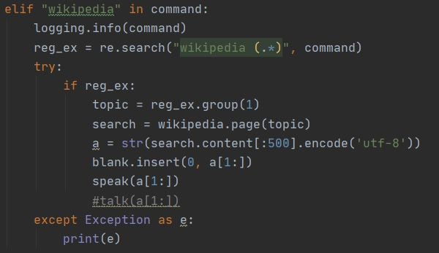
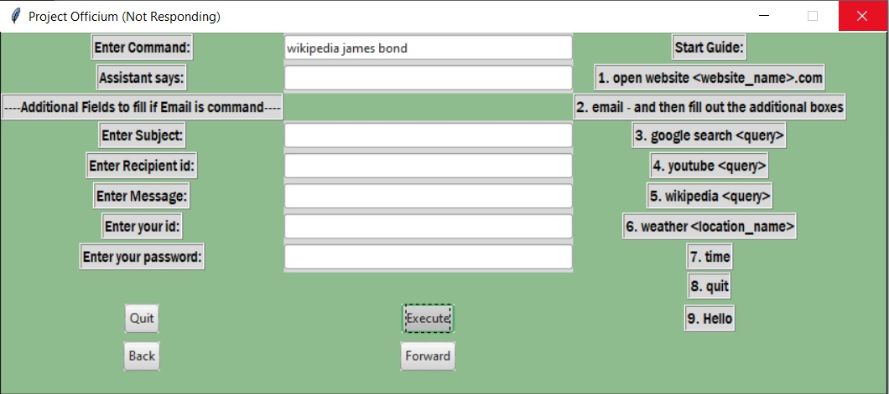
The Functions Performed (Cont’d)
Fig. 15 interface when doing Wikipedia search

Slide 17
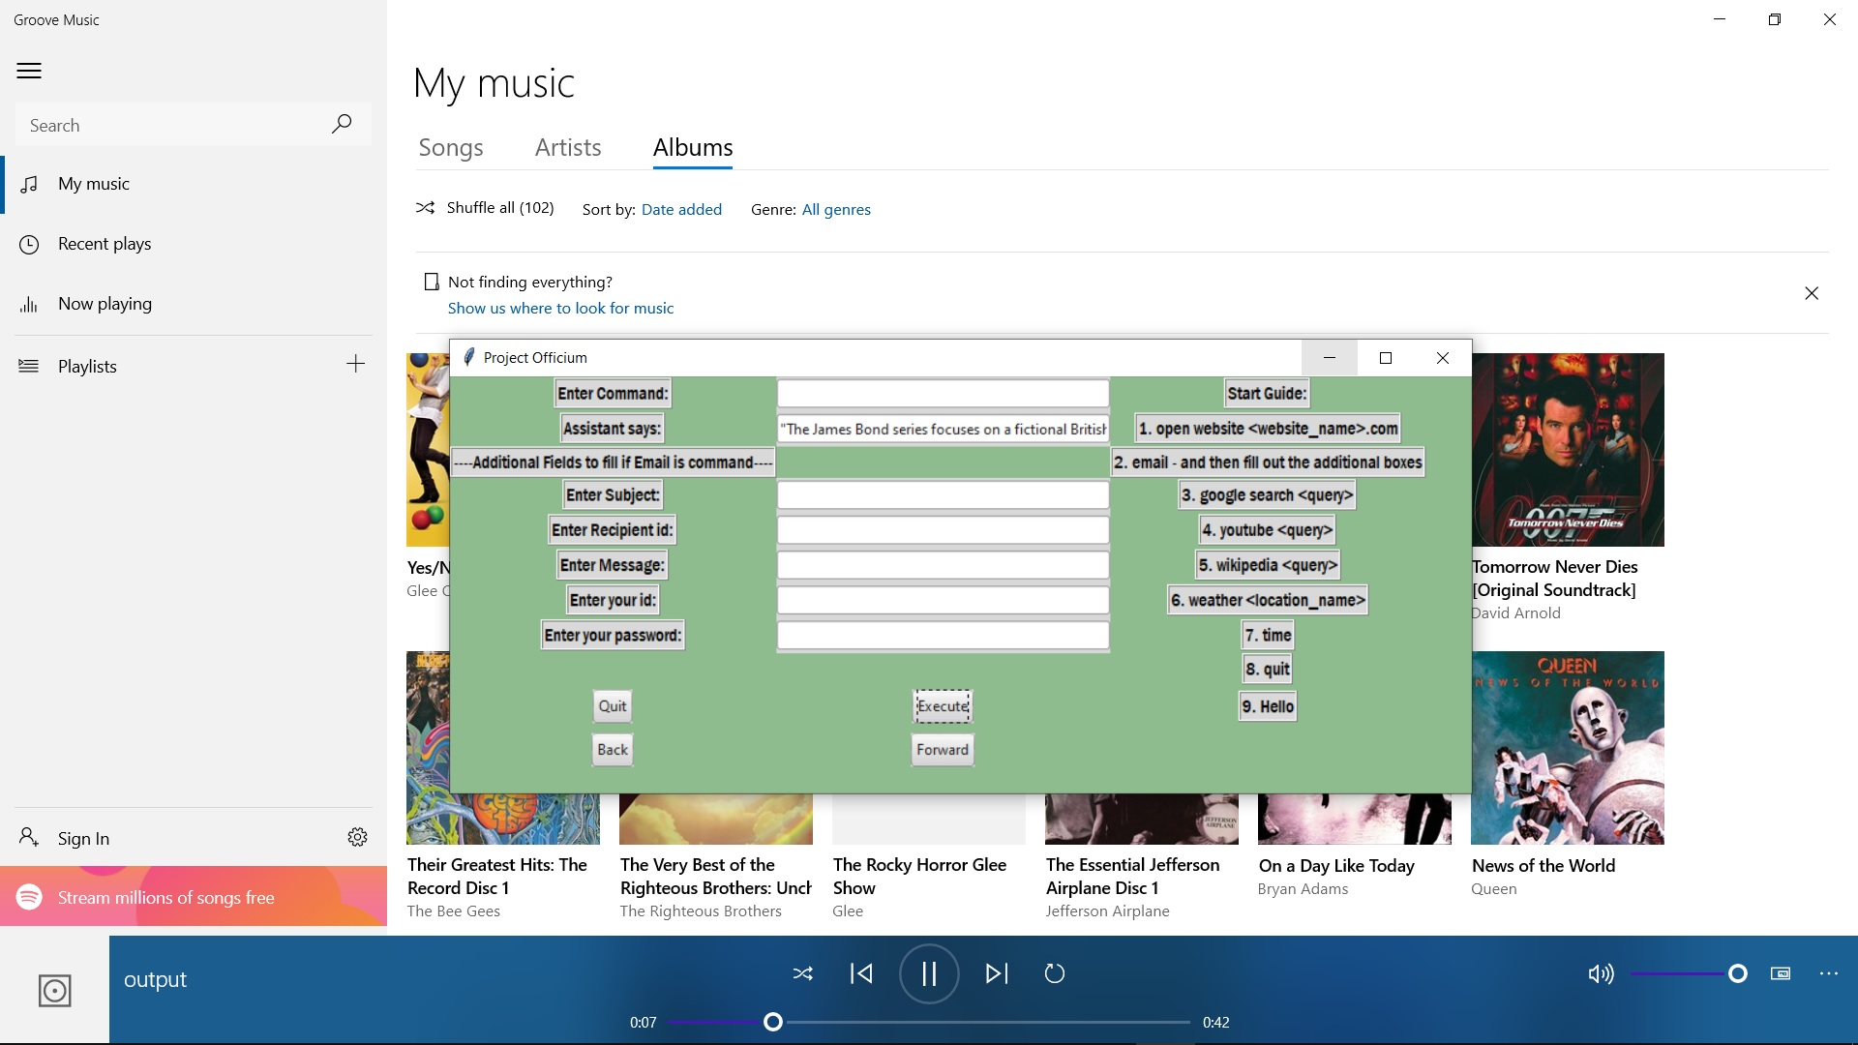
Note: Output for a Wikipedia search has output in both text – through the “Assistant says” field in the GUI – and speech – played via media player through the Speak function.

Slide 18
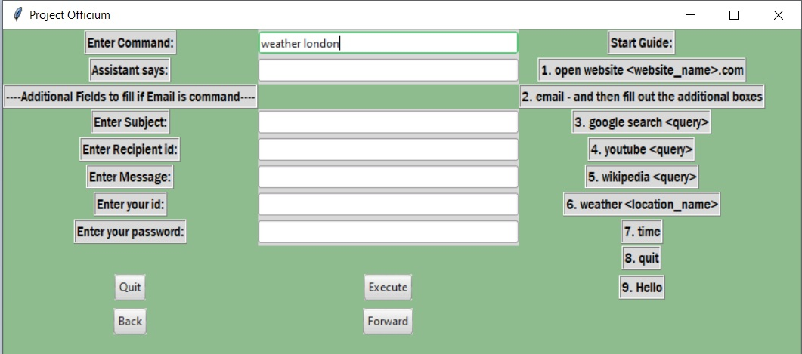
The Functions Performed (Cont’d)
The sixth function is concerning the weather report:
This is done using the Python Open Weather Module which is essentially a wrapper library for Open Weather Maps web API’s.
This is effectively a quick and easy consumption of Open Weather Maps data for Python applications.

Slide 19
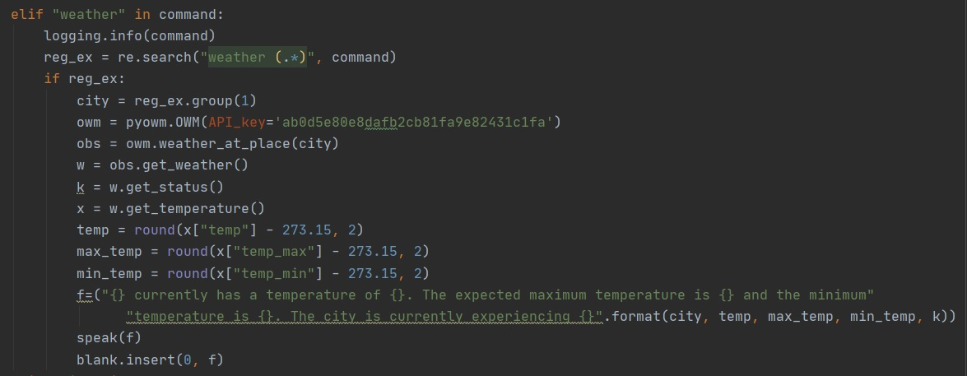
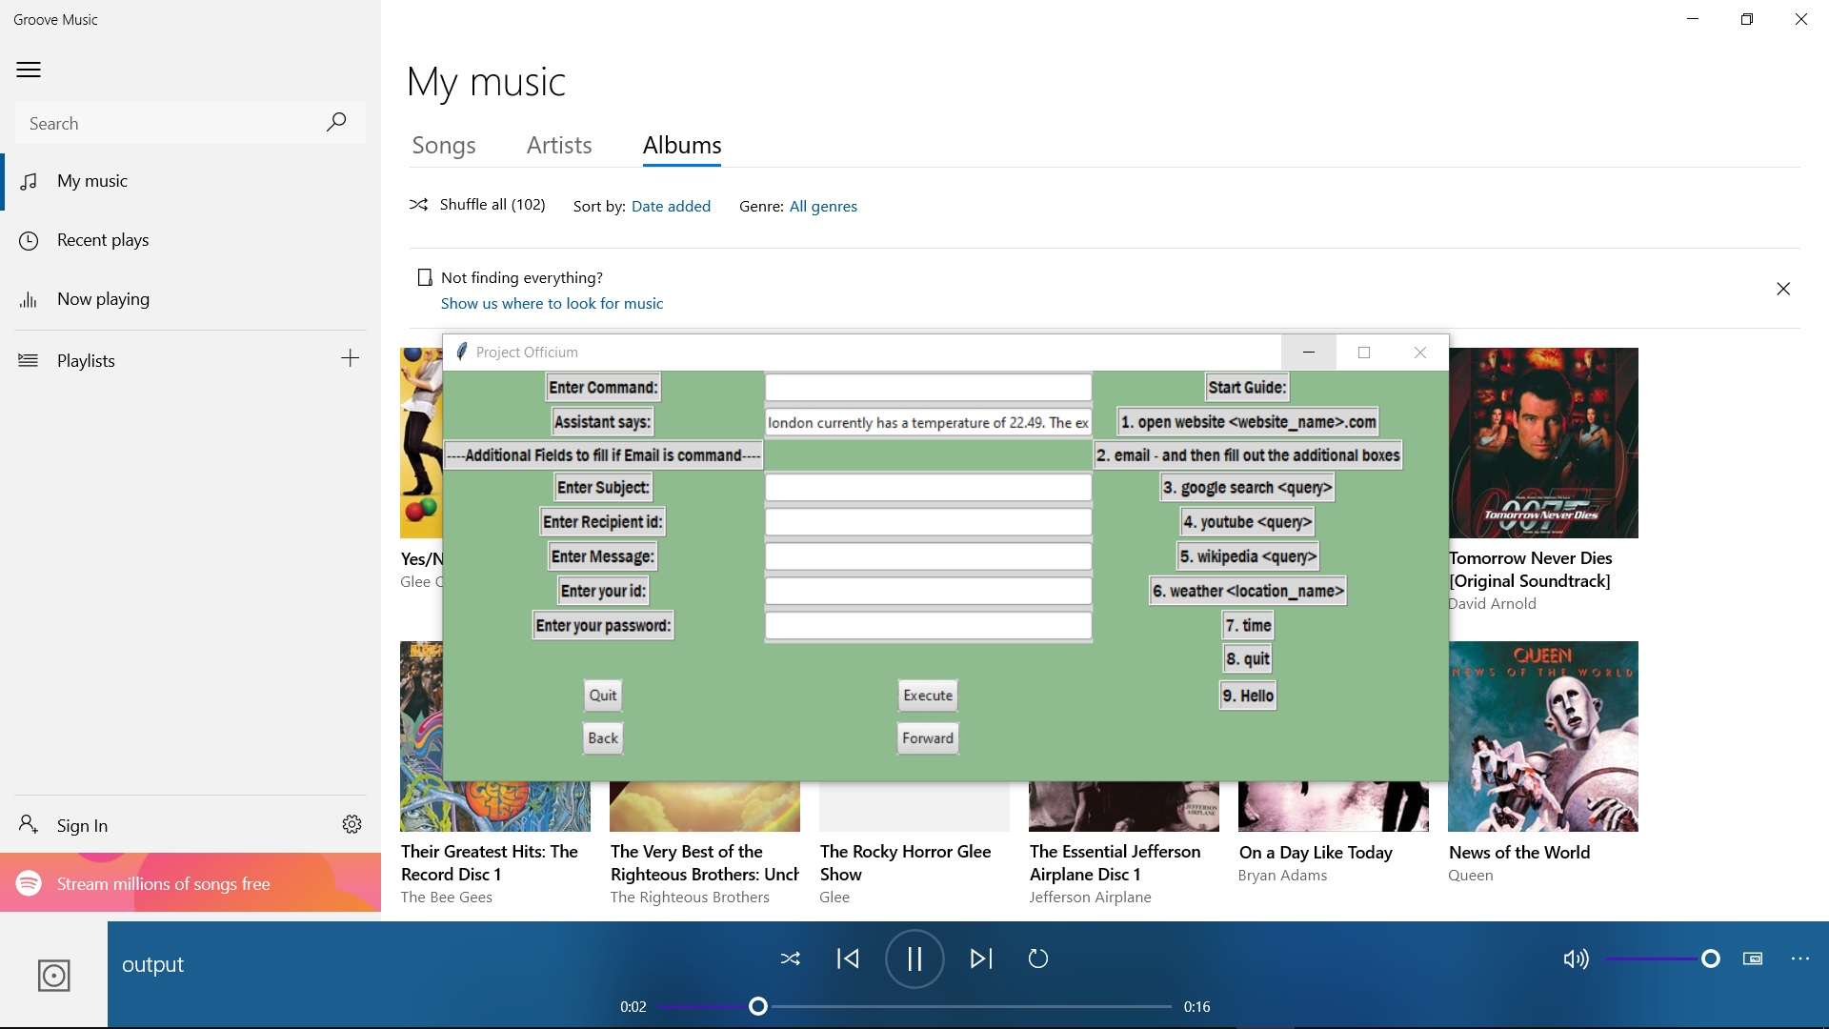
The Functions Performed (Cont’d)
Fig. 19 Output for weather command
Note: Output for a weather command has output in both text – through the “Assistant says” field in the GUI – and speech – played via media player through the Speak function, as seen in Fig. 16.

Slide 20
The Functions Performed (Cont’d)
The remaining functions are simple and self-explanatory, they include:
Time: Provides time update by reading the system clock.
Hello: Provides an appropriate salutation on basis of the time of day
Quit: Terminates the program

Slide 21
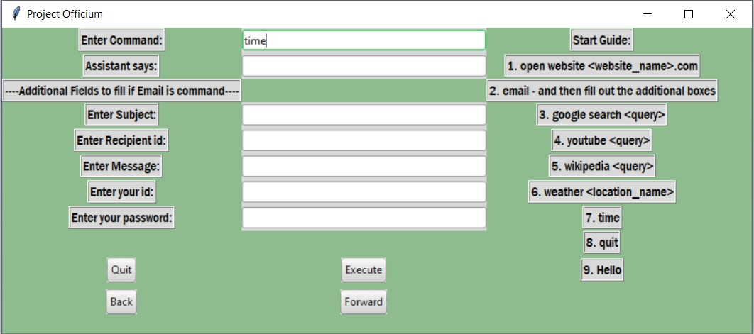


The Functions Performed (Cont’d)
Fig. 21 Interface for salutation command
Fig. 22 Interface for quit command
Note: Output for these commands is solely audio which is played through the talk function thus, direct output.

Slide 22
Data Structures Implementation
We initially implemented two stacks using the adapter design pattern.
Purpose of these stacks was to handle history of the user’s usage of the assistant exactly along the same lines as a web browser does for internet history.
In the GUI we have two buttons Back and Forward that allow us to traverse backwards and forwards in the history of commands.
Whenever a command is entered, it is pushed onto the Back stack and thus, recorded in history.
The further we cycle backwards, commands are popped from the Back stack and then pushed onto the Forward stack.

Slide 23
Data Structures Implementation (Cont’d)
If the history is empty is either direction and we try to traverse backwards and forwards, the program lets us now that history is indeed empty.
Problem with adapter design was that it led to a amortized bound such that a typical call to push and pop functions takes O(1) constant time but there is occasionally a O(n) worst case – when the operations cause the list to resize its underlying array.
Fixing the amortized bound required the restriction of the size of both stacks, thus, after a appropriate cap, both stacks are emptied.
In order to prevent a contradiction between this stack clearance and history recording, we thus, implement a log file of the operations of the program, which in text format also keeps track of the user’s history – done using the INFO level of the logging module.

Slide 24
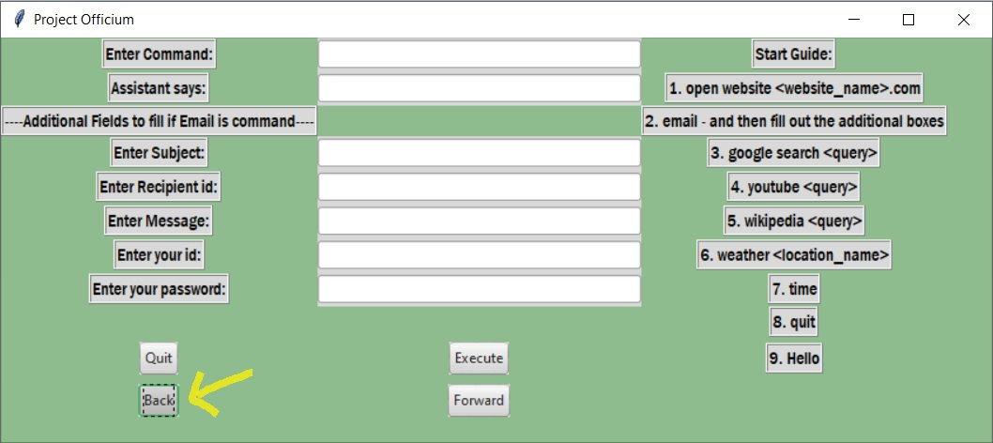
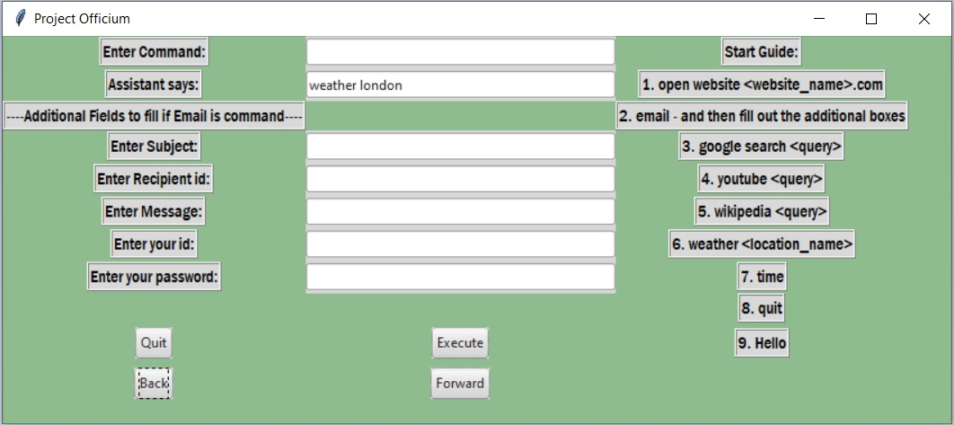
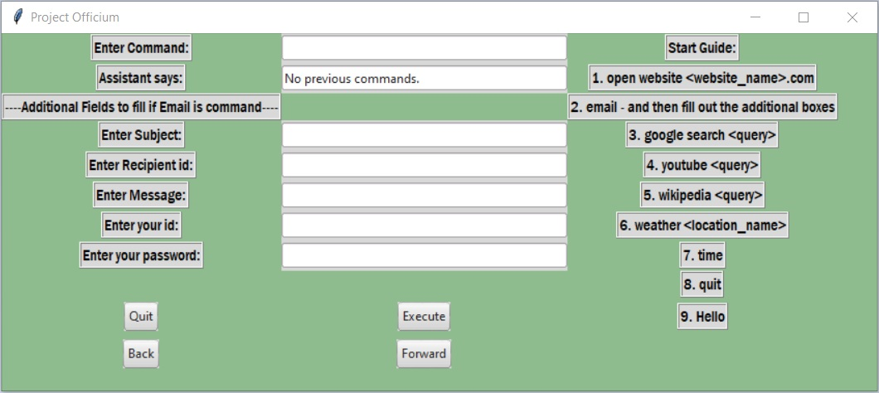
Fig. 24 Interface result when traversing backwards. Last command that we did was check the weather for London thus, that is what is shown
Fig. 25 Interface result for when traversal in the previous history direction is not possible – if there is no history recorded of if we reached starting point such that there is no prior history

Slide 25
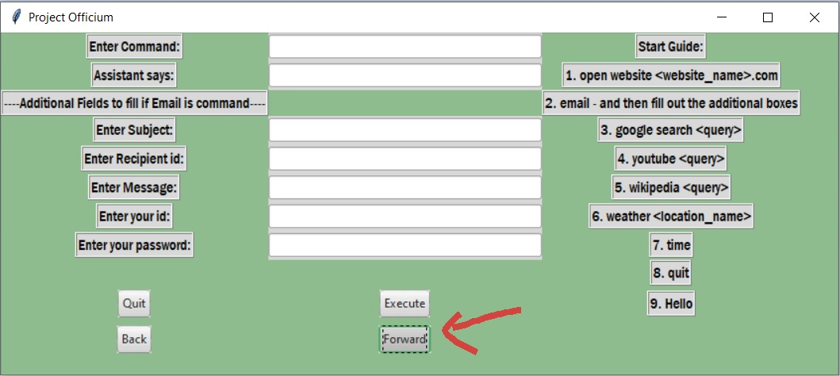
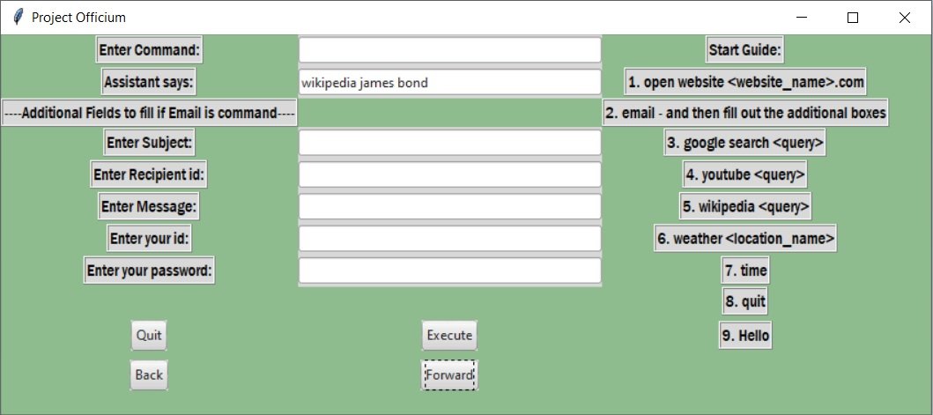

Fig. 27 Interface result when traversing forwards. Having traversed forward after reaching the end of the back stack thus, we see the Wikipedia search command.
Fig. 28 Interface result for when traversal in the forward based direction history direction is not possible.

Slide 26
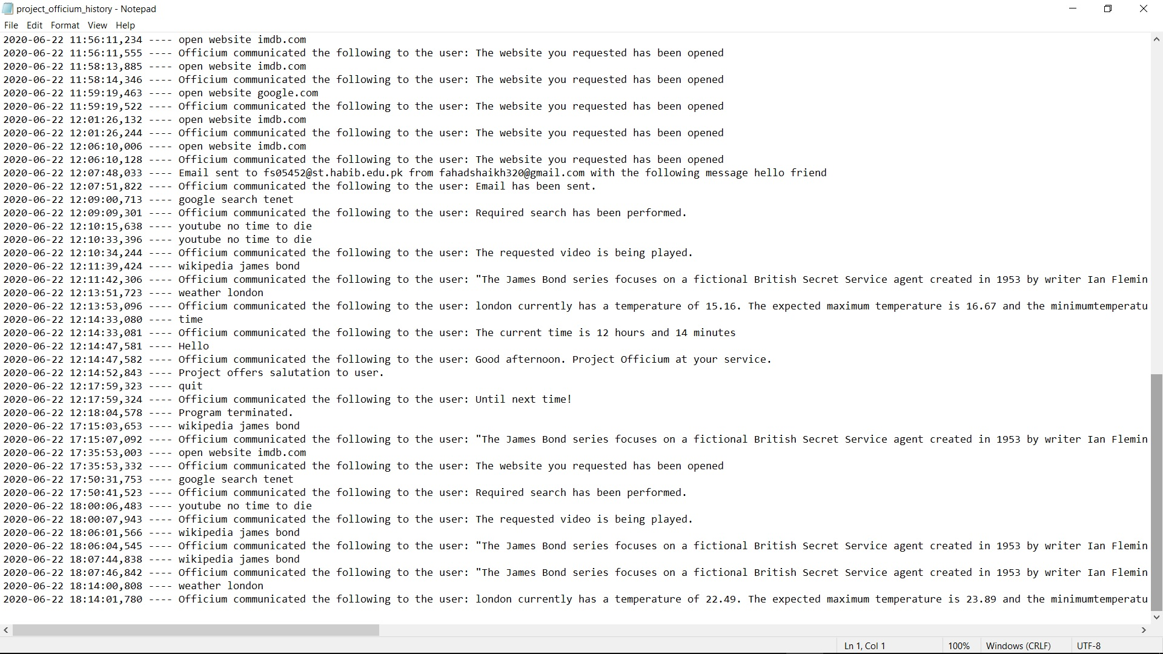
Fig. 29 The implemented log file that records the history and all important events in the programs execution.
Note: For better and clearer understanding of the data structures implementation, please watch the recorded demo. It is easier to understand as the execution before your eyes.

Slide 27
Challenges Addressed
Improvement of the efficiency of the assistant to user communication.
This was resolved by introducing a another speech function i.e. the Talk function (as previously mentioned), this allowed for faster direct dissemination of information in appropriate situations – these situations pertained to smaller messages.
Resolving the amortized bounds of the two stacks used for the recording of the history.
This was resolved by restricting capacity of the stack and introducing a log file that helps with history management.
Automatic execution of history traversal whenever program was launched.
This was resolved by altering the mapping of the Back and Forward buttons in the GUI as anonymous functions – using the Lambda function.

Slide 28
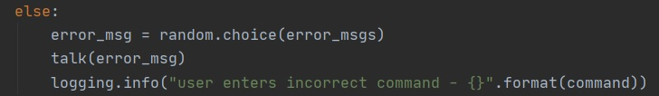
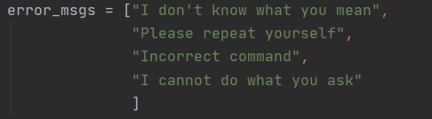
Dealing with errors
Dealing with errors is quite simple, should a user make a mistake in a command, the program simply randomly chooses 1 of 4 error messages and informs the message via the Talk function.
Fig. 31 The randomly chosen error messages

Slide 29
Work Load Distribution
Tasks | Person Involved
Implementation of GUI | Fahad: Creation of all GUI elements and placement; Haris: Integration with source code
Speech Functions | Mariam: Speak & Talk functions Fahad: Talk function
Data Structures – Implementation and Problem resolution | Handled by all 3
Google Search | Haris
Email | Mariam
Google Search | Fahad
Youtube | Fahad & Mariam

Slide 30
Work Load Distribution
Tasks | Person Involved
Wikipedia | Mariam & Haris
Weather | Fahad
Remaining functions: Time; Hello; Quit | Fahad
Log file and error handling | Fahad & Haris

Slide 31
FIN

